Slide 1

INTERNSHIP REPORT PRESENTATION
Arts & Creation Studio
Web Development Internship at Raj Multimedia Education
Intern Name :- Mandaviya Ankit
Roll No :- 89
Mentor Name :- Bajrang Sir
Company Name :- Raj Multimedia
Personal Details
● Presented by Mandaviya Ankit ●

Slide 2
INTERNSHIP INFO
Duration: 120 Hours
Domain: Web Development & Designing
Department: Ui & Ux
Objective: To gain practical experience and industry exposure

Slide 3
ABOUT THE COMPANY — Raj Multimedia Education
Raj Multimedia Education is a multimedia training institute that provides IT and digital skills training.
The institute offers courses such as web design, graphic design, video editing, UI/UX, and digital marketing.
The company’s mission is to provide students with practical knowledge and career opportunities.
Along with training, job assistance and recognized certification are also provided.

Slide 4
WORK DONE DURING INTERNSHIP
Designed social media posts using Canva
Created and edited designs using Adobe Photoshop
Developed and managed a website using WordPress
Designed a personal portfolio using Figma

Slide 5
CANVA
Canva Design
Designed a professional logo to establish a clear and recognizable brand identity
for the website.
Created marketing and branding posts to promote services and ensure visual consistency across designs.
Developed a flyer and a visiting card to support professional communication and brand presence.
Designed a banner and an all-work poster to visually present all services offered on the Arts & Creation Studio website.
Design Explanation
The all-work poster was created to combine all website services into a single,
visually appealing layout.
It organizes the services clearly, using simple design and alignment to make it easy for
viewers to understand all offerings at a glance.
The poster highlights key services while maintaining consistency
with the overall brand identity.

Slide 6



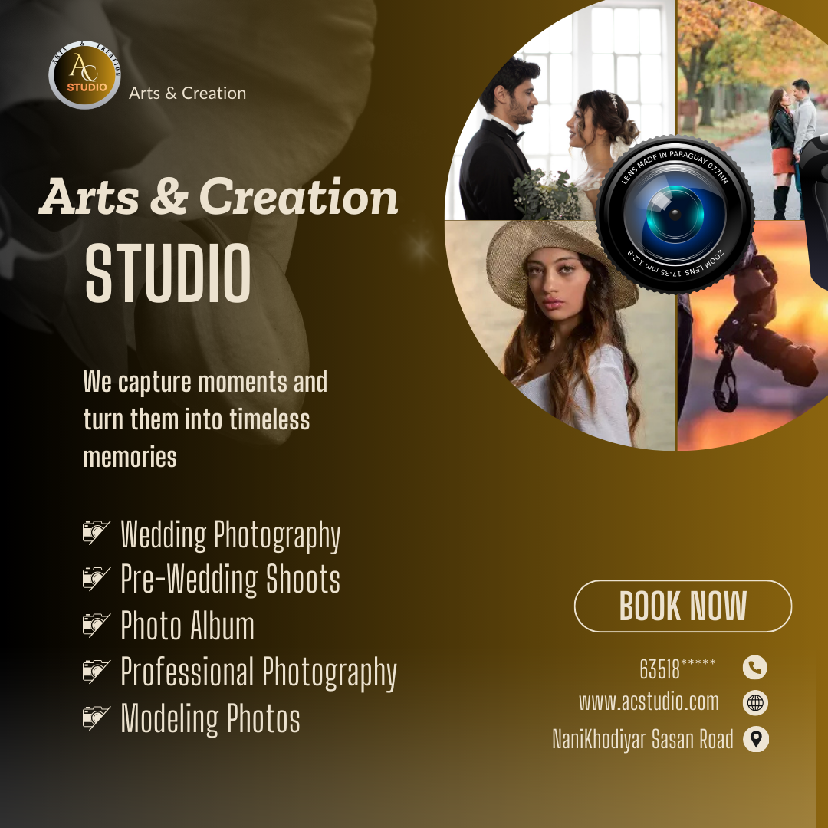
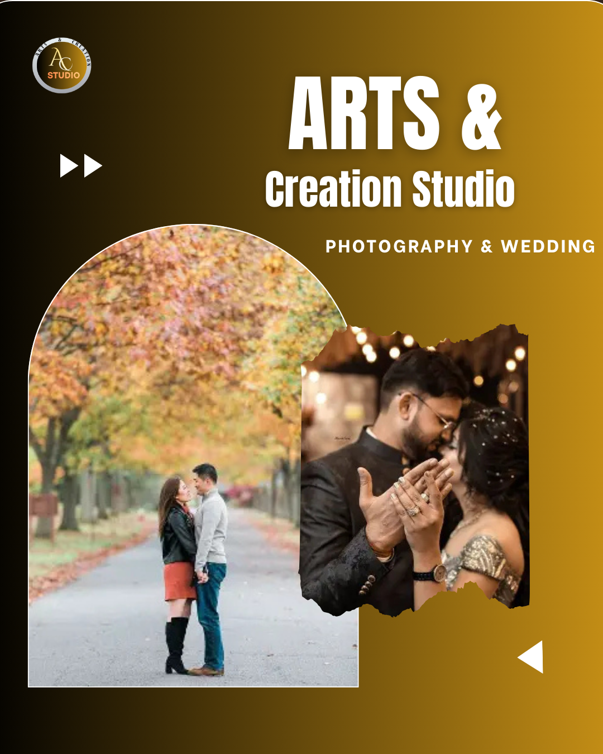
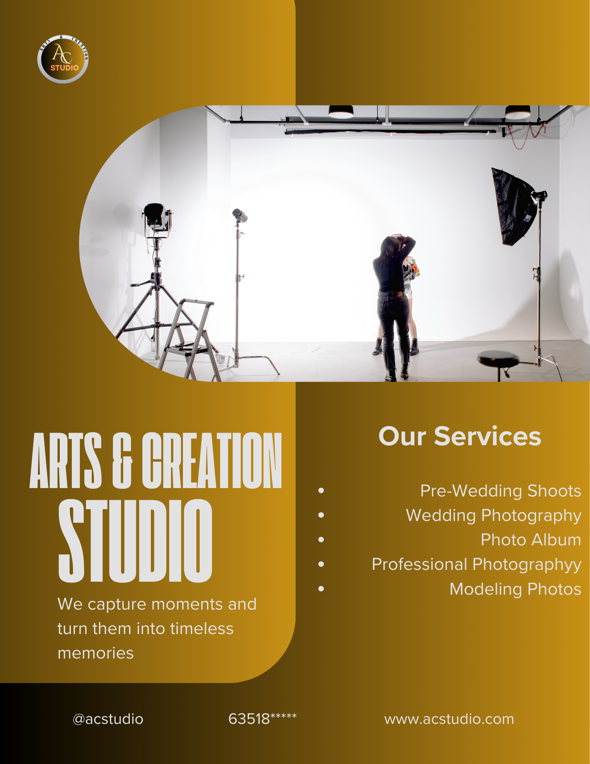
Canva Work Images
1 :- LOGO
2 :- BANNER
3 :- VISITING CARD
4 :- MARKETING POST
5 :- BRANDING POST
6 :- FLAYER

Slide 7
2) Adobe Photoshop
Adobe Photoshop Design
During my internship, I used Adobe Photoshop to create visual content for the AC Studio website and its promotion.
I designed three creative slides for the website home page, focusing on layout, typography, and visual balance to enhance the overall look of the website.
Along with website content, I also created a promotional
YouTube thumbnail for the topic “How to Shoot Cinematic Video”.
Design Explanation
The home page slides were designed to make the website more attractive and engaging for visitors while maintaining a consistent design style.
The YouTube thumbnail was created with strong visuals, clear text, and cinematic elements to grab user attention and encourage clicks,
helping in effective website and content promotion.

Slide 8
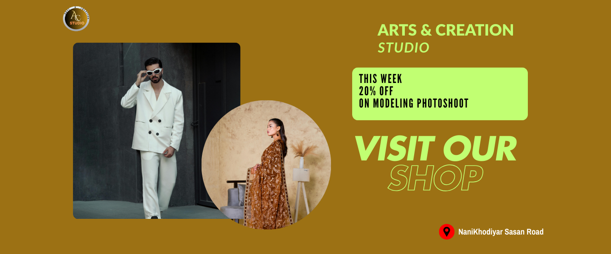
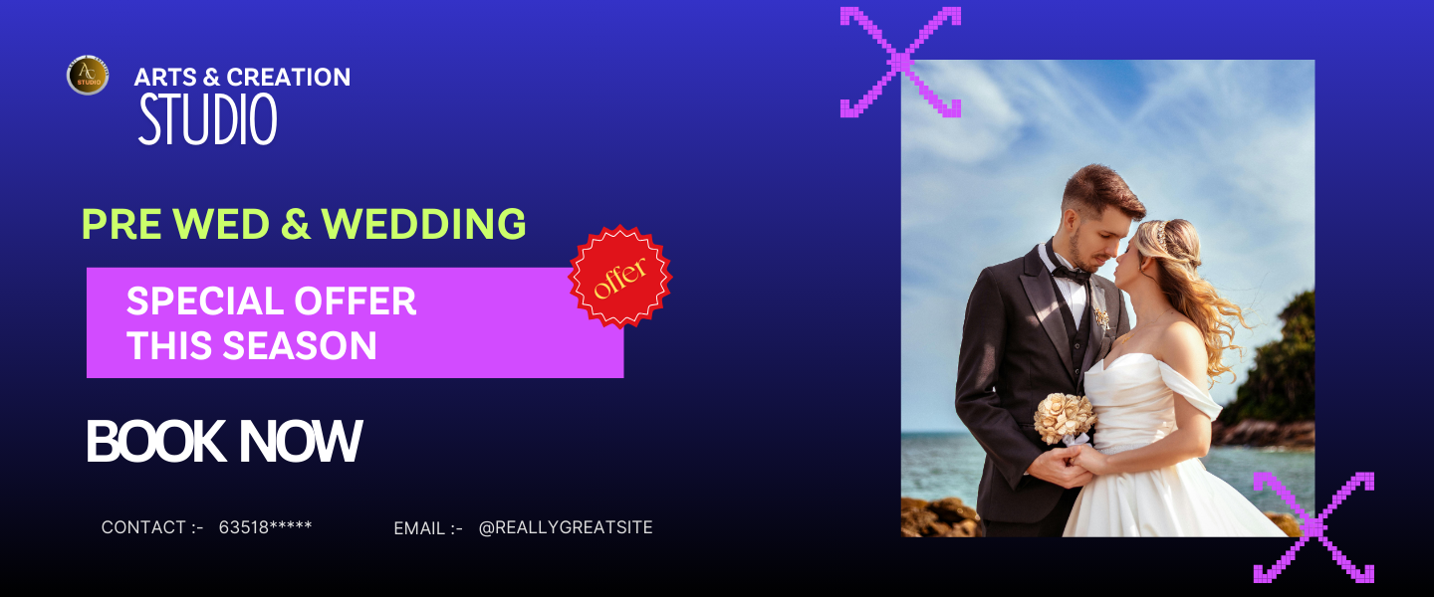

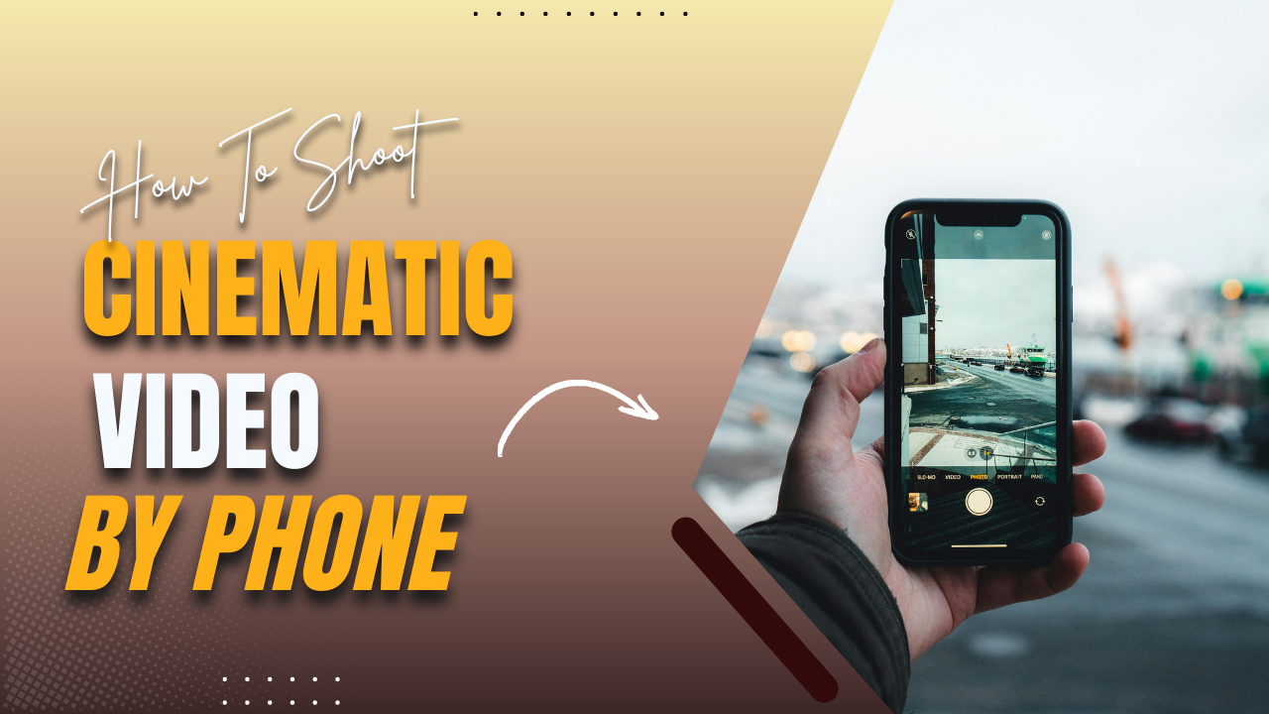
Adobe Photoshop Images
1) Slider 1
2) Slider 2
3) Slider 3
4) Youtube Thumbnail

Slide 9
3) XAMPP
XAMPP Explanation
XAMPP is a free and open-source local server software that provides Apache Server, MySQL Database, in one package. It is used to run and test websites locally on a computer before hosting them online.
Use of XAMPP
XAMPP is used to create a local development environment where websites can be developed safely without an internet connection. It helps in testing website functionality, design, and database operations before making the website live.
Database Creation Using XAMPP
Using phpMyAdmin in XAMPP, a database is created to store website data such as pages, content, images, and settings. This database is later connected with WordPress to manage dynamic website content.

Slide 10
4) Word Press
About WordPress
WordPress is a simple and easy platform used to create and manage websites. It helps in designing web pages and updating content without coding
Website Created Using WordPress
Using WordPress, I created a complete website named AC Studio on a local server with the help of XAMPP. The website showcases AC Studio’s services, creative work, and contact information. I structured the website to be user-friendly, visually appealing, and easy to navigate. WordPress allowed me to manage pages, add content, insert images, and customize layouts to match the brand style of AC Studio.
Pages Created in the Website
Home Page: Top slider with three slides and two popular packages.
Our Packages Page: Lists all service packages with brief info.
About Page: Info about AC Studio, its purpose, and vision.
Contact Page: Contact details and inquiry form.

Slide 11
5) Figma
About Figma
Figma is a cloud-based design tool used for creating UI/UX designs, websites, apps, and digital portfolios. It allows designers to work on layouts, wireframes, and prototypes easily. Figma works in a browser and also has a desktop app, so multiple people can collaborate in real-time on the same design. It is simple to use, even for beginners, and is widely used in professional design work.
Portfolio Created Using Figma
Created a professional portfolio to showcase my personal and academic details.
Added Profile information to introduce myself.
Included Education details to show my background.
Listed Skills to highlight my technical abilities.
Designed a clean and organized layout for the portfolio, making it Easy to read and Visually attractive.
Learning from Figma
Learned how to structure a portfolio and design pages for clarity.
Improved understanding of Colors, Typography, and Visual Hierarchy.
Gained practical experience in UI/UX Design and Digital Portfolio Creation.

